Slide 1
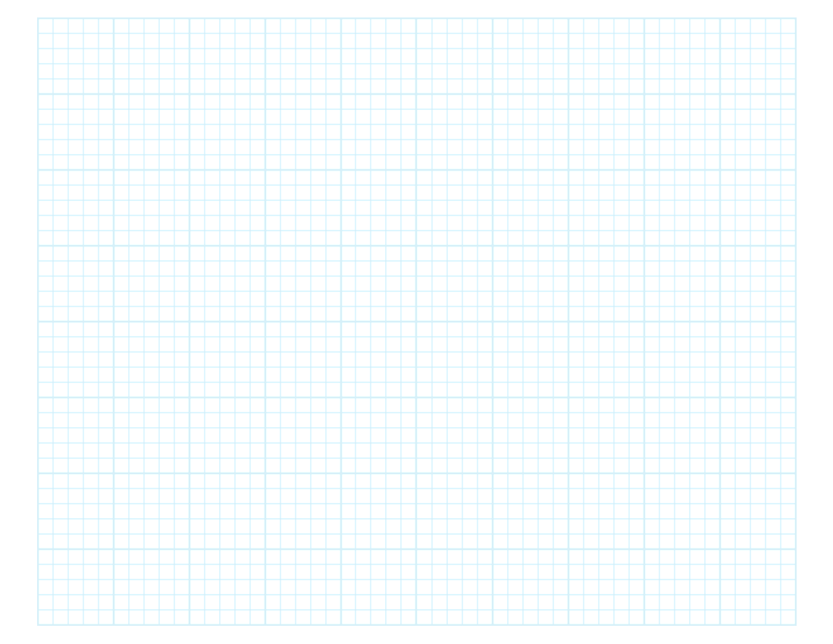

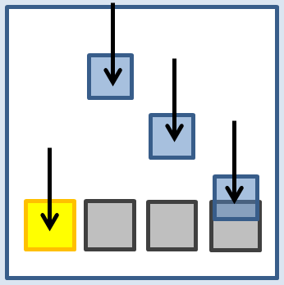
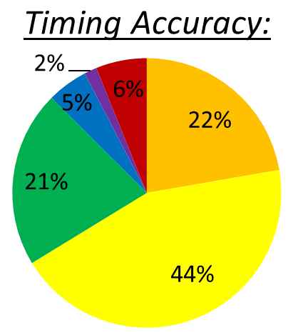
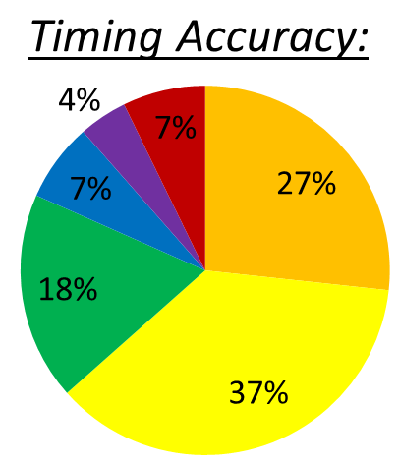
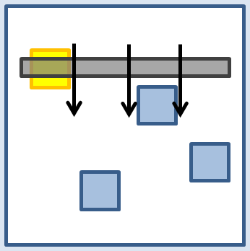




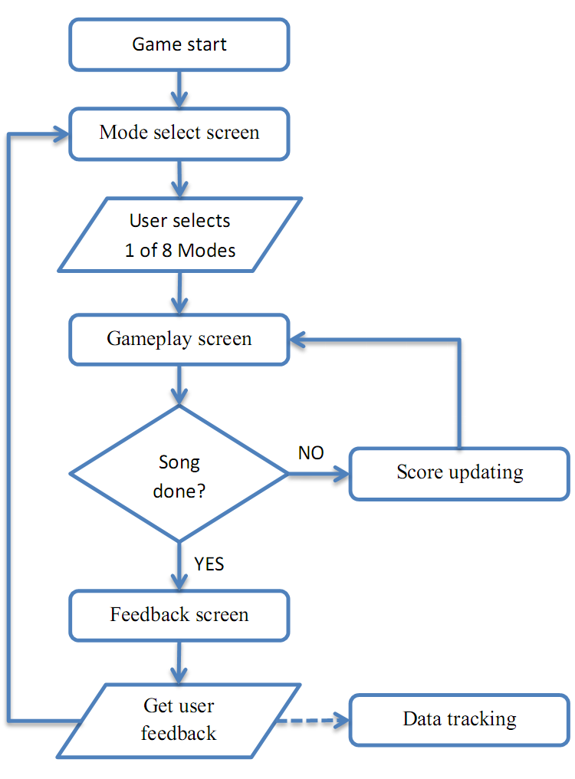
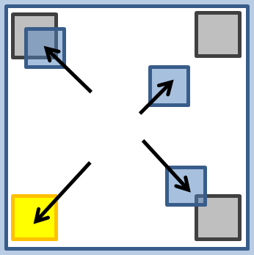
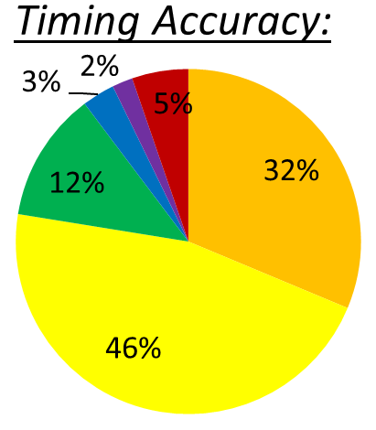
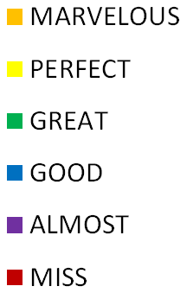
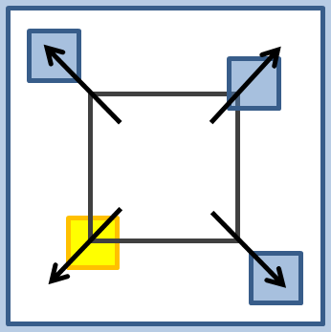
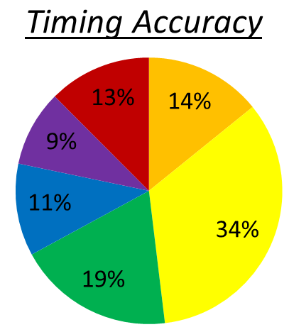

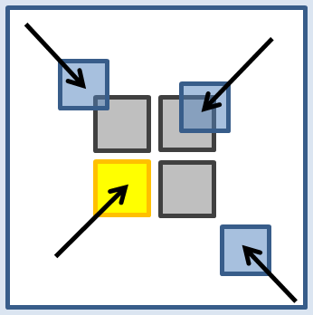
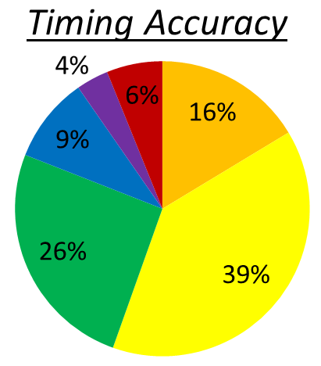
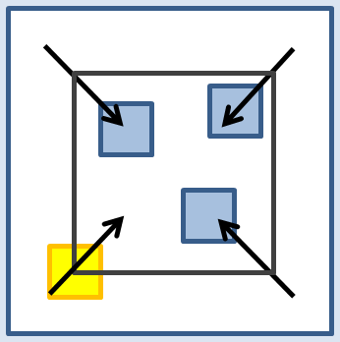
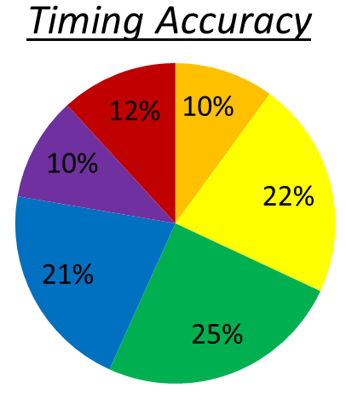
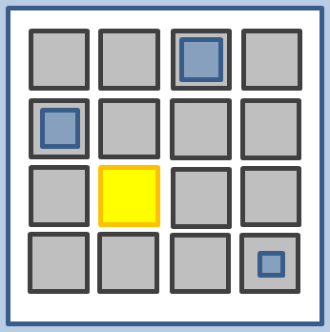
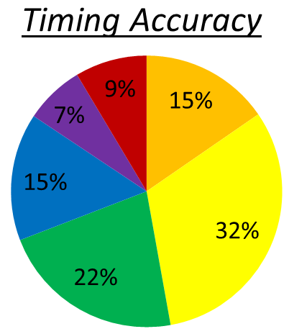
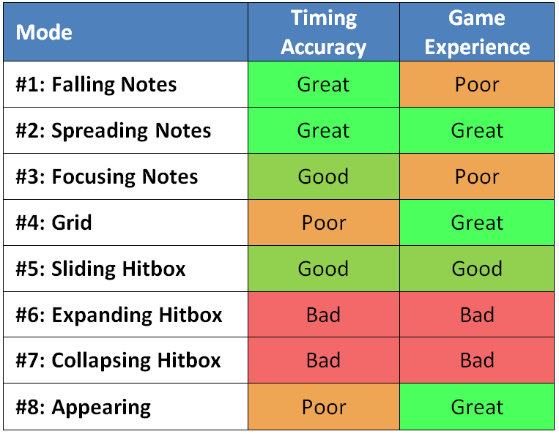
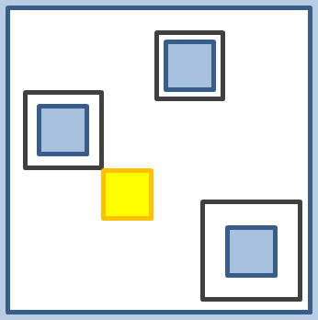
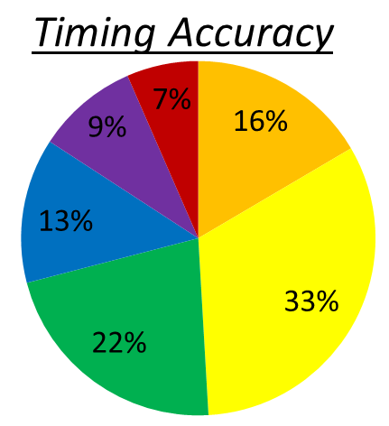


Designing Rhythm Game Interfaces for Touchscreen Devices
Philip Peng, Faculty Advisor: Stephen H. Lane
Design 1: Fall
Feedback:
http://beatsportable.com
Design 5: Slide
Feedback:
Hit Accuracy
Hit Accuracy
Abstract:
This project focuses on comparing different user interface designs for rhythm games on touchscreen devices. This is accomplished through the development of prototype rhythm games and analyzing collecting gameplay data.
Implementation:
“Beats2 Prototypes”, a rhythm game designed for Android tablets, was published on Google Play. This poster presents the eight interface designs prototyped in the app and their respective data collection summaries.
Category | Ratings | Avg
Challenge |  | 3.69
Intuitive |  | 4.18
Fun |  | 3.76
Unique |  | 2.43
Overall |  | 2.33
Category | Ratings | Avg
Challenge |  | 4.39
Intuitive |  | 3.50
Fun |  | 4.07
Unique |  | 4.10
Overall |  | 3.80
Moving notes fall toward fixed hitboxes from top to bottom
Rhythm Games: Dance Dance Revolution, Guitar Hero, Beatmania IIDX
Moving hitbox fall toward fixed notes appearing from top to bottom
Rhythm Games: DJMax Technika
Hit Accuracy:
During gameplay, note hits are assigned hit accuracy values based on the difference between expected and actual note hit times. The distribution of these values reflect on how the user interface affects the user’s timing accuracy.
A high percent of “MARVELOUS” and “PERFECT” values means that the interface allows for accurate visual recognition (note timing window) and fast user reactivity (note tapping action).
Hit Accuracy
Design 2: Spread
Feedback:
Hit Accuracy
Design 6: Expand
Feedback:
Hit Accuracy
Category | Ratings | Avg
Challenge |  | 3.84
Intuitive |  | 3.94
Fun |  | 3.75
Unique |  | 3.97
Overall |  | 4.00
Category | Ratings | Avg
Challenge |  | 4.56
Intuitive |  | 2.84
Fun |  | 3.36
Unique |  | 4.54
Overall |  | 3.41
Moving notes slide toward fixed hitboxes from centre to corners
Rhythm Games: none
Expanding hitbox grows toward fixed notes from centre to corners
Rhythm Games: none
Design 3: Focus
Feedback:
Hit Accuracy
Design 7: Collapse
Feedback:
Hit Accuracy
Category | Ratings | Avg
Challenge |  | 3.79
Intuitive |  | 3.76
Fun |  | 3.42
Unique |  | 3.79
Overall |  | 3.54
Category | Ratings | Avg
Challenge |  | 4.26
Intuitive |  | 2.65
Fun |  | 3.04
Unique |  | 4.18
Overall |  | 3.23
Feedback:
At the end of a song, the user is prompt to give qualitative feedback ratings on the gameplay experience. These 1-5 star ratings reflect on various aspects of game experience.
Challenge: Difficulty of gameplay. More difficult = higher skill ceiling.
Intuitive: Usage learning curve. More intuitive = higher reactivity.
Fun: Game enjoyability. More fun = more returning users.
Unique: Novelty of design. More unique = more first time users.
Overall: General evaluation of gameplay experience.
Moving notes slide toward fixed hitboxes from corners to centre
Rhythm Games: Gitaroo Man Lives!, Hatsune Miku: Project DIVA
Collapsing hitbox shrink toward fixed notes from corners to centre
Rhythm Games: none
Design 4: Grid
Feedback:
Hit Accuracy
Conclusion:
Based on these results, each interface design was ranked relative to each other in terms of timing accuracy and game enjoyability.
Of the eight designs studied, Design #2 is the best candidate for usage in future rhythm game development.
Design 8: Appears
Feedback:
Hit Accuracy
Category | Ratings | Avg
Challenge |  | 4.27
Intuitive |  | 3.81
Fun |  | 4.14
Unique |  | 3.85
Overall |  | 3.98
Category | Ratings | Avg
Challenge |  | 3.93
Intuitive |  | 4.13
Fun |  | 4.33
Unique |  | 4.02
Overall |  | 4.20
Expanding notes grow in fixed hitboxes at grid points
Rhythm Games: jubeats
Collapsing hitboxes shrink around fixed notes appearing at grid points
Rhythm Games: Osu! Tatakae! Ouendan!
Senior Project Poster Day 2012 – Department of Computer and Information Science

